Slide 1
Cloud Computing – EE655/EE755: Introduction
Dr. Leon Jololian
Electrical and Computer Engineering Department

Slide 2
Topics Covered
Virtual Machines
Cloud-based Storage
Tools for the Cloud
Mobile Services on the Cloud
Internet of Things

Slide 3
Learning Objectives
What is the “Cloud”?
Facts, Trends, Statistics
Public, Private, and Hybrid Cloud
Benefits and Limitations
Infrastructure, Platform, and Software as a Service

Slide 4
What is the Cloud?
The Cloud is the Internet.
The size of resources attached to it is massive.
The Cloud is a utility.
Services are provided on a pay-as-you-go model.
Google’s infrastructure spans 30 data centers around the world with over a million computers.

Slide 5
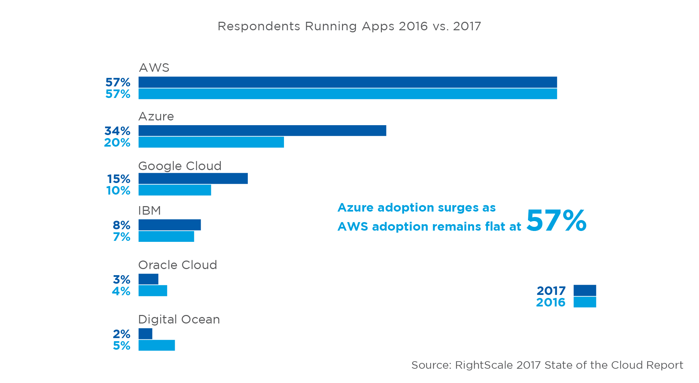
Public Cloud Adoption

Slide 6
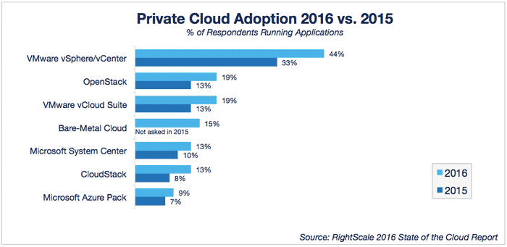

Slide 7
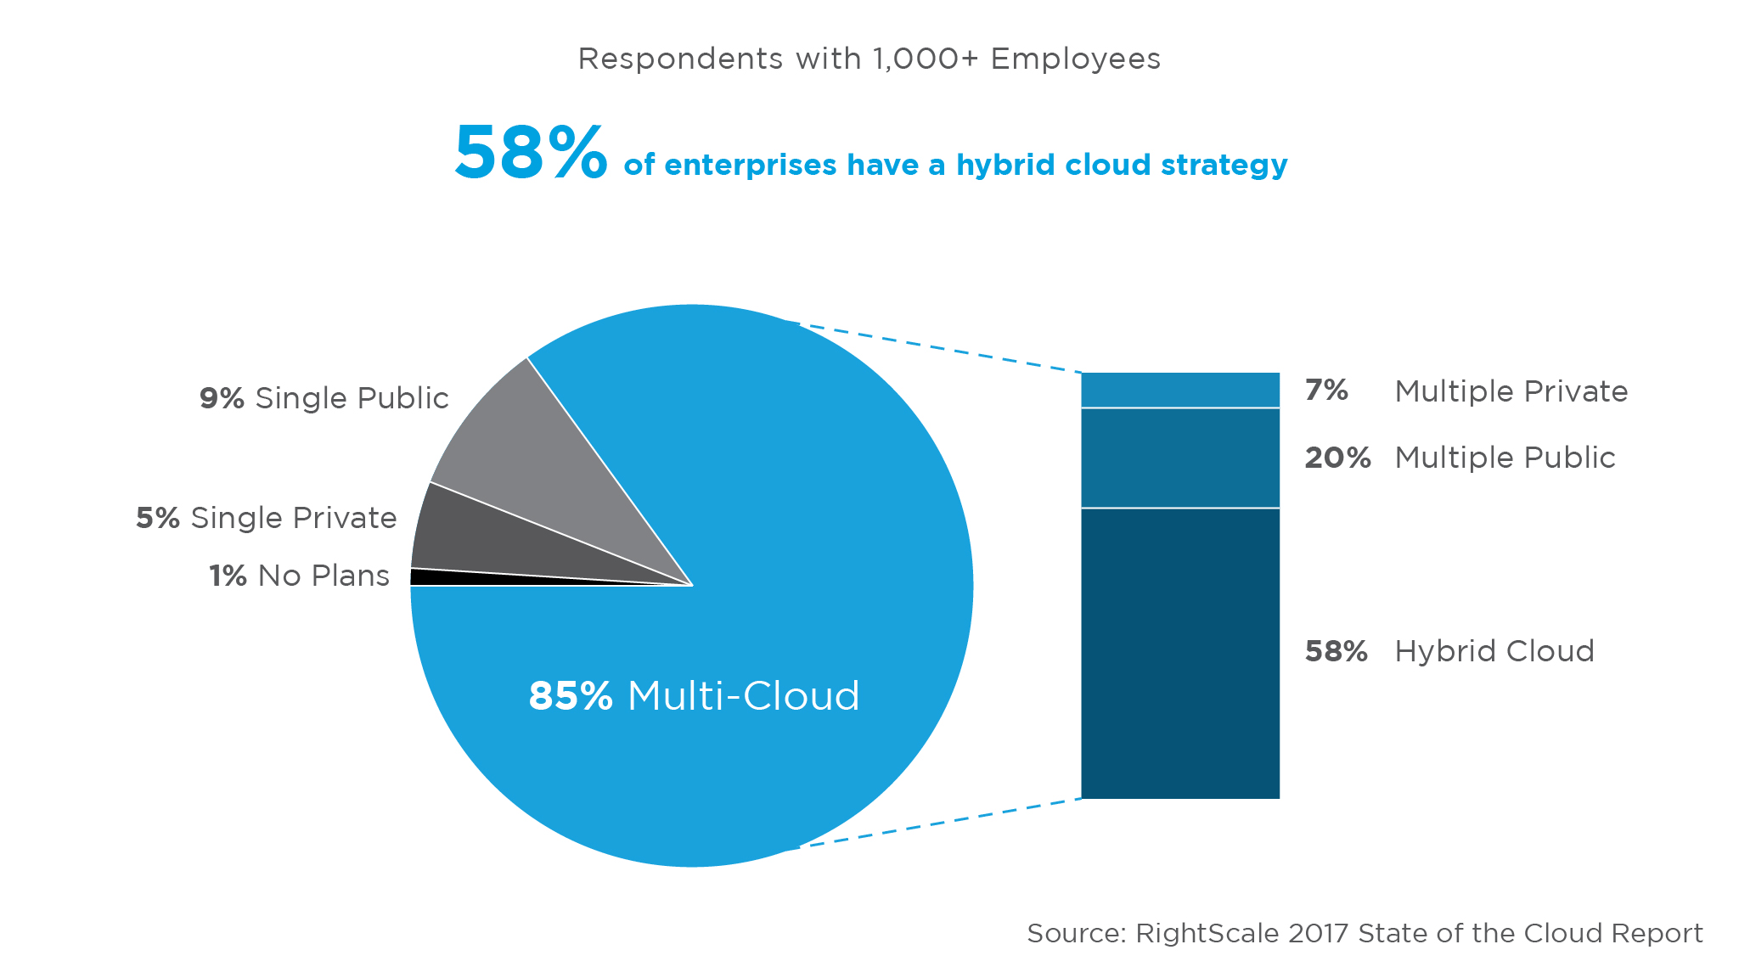
Multi-Cloud Infrastructure

Slide 8
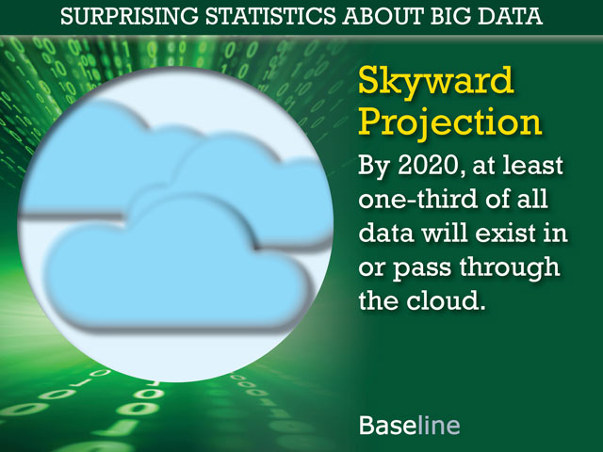

Slide 9
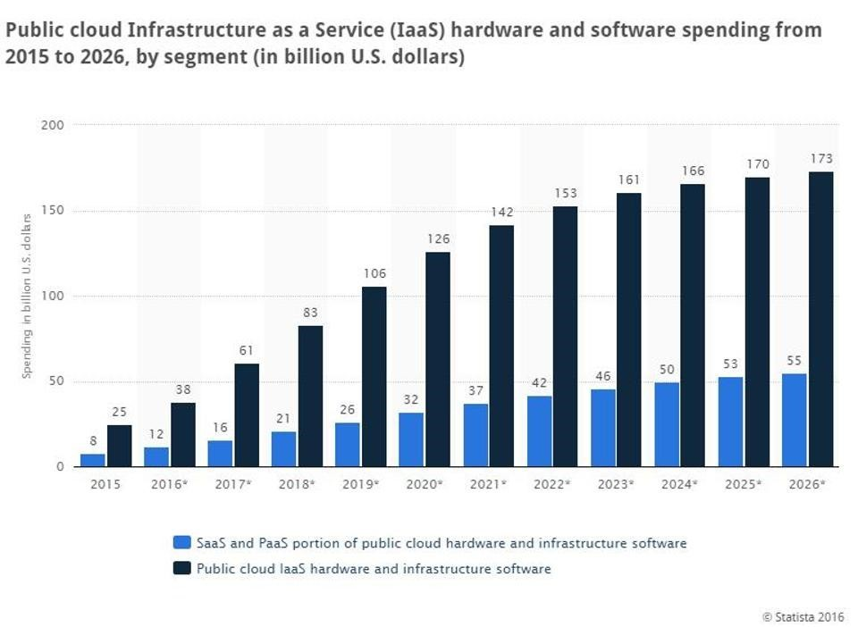

Slide 10
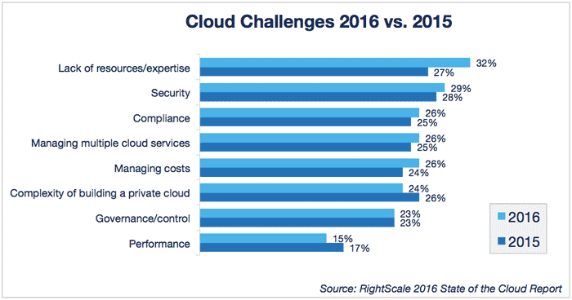

Slide 11
The current state of cloud computing
Cloud computing services are quickly becoming the biggest revenue generator for leading software companies of the present day.
Think tanks have collectively predicted that:
Microsoft will generate at least 30% of its annual revenue via cloud based software services by 2018.
Amazon has seen year-over-year growth of 68% from its cloud services, a number that’s expected to exponentially increase by 2018.
Annual global spending on cloud services is expected to increase by a 19.4% Compound Annual Growth Rate (CAGR) by 2019.

Slide 12
How Cloud Computing will affect us
Apps in the cloud instead of local on device.
Information will become cheaper, ubiquitous.
The Cloud will enable new social services.
New apps will be easier to create (standards).
Lesser role for proprietary operating systems.
You will be connected to the cloud all the time.

Slide 13
Defining Cloud Computing
It refers to apps and services that run on a distributed networks using virtualized resources and accessed by common Internet protocols and networking standards.
Resources are virtual and limitless and that details of the physical systems on which software runs are abstracted from the user

Slide 14
Two Classes of Clouds
Clouds can be based on deployment model
Location and purpose
Ex: private, public, hybrid
Clouds can be based on service model
Type of service
Ex: SaaS, PaaS, IaaS
Deployment vs. Service Model
SaaS PaaS IaaS
Private Public Hybrid

Slide 15
Public Cloud
A public cloud is one based on the standard cloud computing model, in which a service provider makes resources, such as applications and storage, available to the general public over the Internet.
Public cloud services may be free or offered on a pay-per-usage model.
Easy and inexpensive set-up because hardware, application and bandwidth costs are covered by the provider. Scalability to meet needs. No wasted resources because you pay for what you use.
Examples of public clouds include Amazon Elastic Compute Cloud (EC2), IBM's Blue Cloud, Sun Cloud, Google AppEngine and Windows Azure Services Platform

Slide 16
Private Cloud
Private cloud is similar to public cloud, including scalability and self-service, but through a proprietary architecture.
A private cloud is dedicated to a single organization.
It is best for businesses with dynamic or unpredictable computing needs that require direct control over their environments.
Shared computing environments aren't suitable for all businesses, such as those with mission-critical workloads, security concerns, uptime requirements or management demands.

Slide 17
Hybrid Cloud
Hybrid cloud uses a mix of on-premises, private cloud and third-party, public cloud services with orchestration between the two platforms.
By allowing workloads to move between private and public clouds as computing needs and costs change, hybrid cloud gives businesses greater flexibility and more data deployment options.
Possible uses: Extension when needed; Big Data processing

Slide 18
Two Essential Concepts
Abstraction of the details of system implementation from users and developers
Applications run on unspecified physical system
Data are stored in locations that are unknown
Administration of systems is outsourced
Virtualization by pooling and sharing resources
Systems and storage can be provisioned as needed
Costs are assessed on a metered basis
Multi-tenancy is enabled
Resources are scaled with agility

Slide 19
Examples of Cloud Computing
Google:
Search engine service
Microsoft:
Azure platform enables .Net Framework apps to run over the Internet
Amazon:
Web services provides infrastructure as a service, allowing you to rent virtual computers

Slide 20
Service Models
Infrastructure as a Service (IaaS):
Provides virtual machines, storage, infrastructure, etc., as resources that can be provisioned
Platform as a Service (PaaS):
Provides virtual machines, operating systems, applications, services, development frameworks, transaction, and control structures
Software as a Service (SaaS):
It is a complete operating environment with applications management, and the user interface

Slide 21
Benefits of Cloud Computing
On-demand self service
Broad network access
Resource pooling
Rapid elasticity
Measured service

Slide 22
Additional Benefits
Lower costs
Ease of utilization
Quality of service
Reliability
Outsourced IT management
Simplified maintenance and upgrade
Low barrier to entry

Slide 23
Limitations of Cloud Computing
It is a more compelling case for small organizations
Limited customization
Latency due to WAN connectivity
Privacy and security
Regulatory compliance

Slide 24
The Cloud Computing Echo System
Business Process (SOA)
Application Services
Platform Services
Infrastructure Services

Slide 25
Software as a Service
SaaS represents a hosted application that is universally available over the Internet, usually through a browser.
This is an alternative model to that of shrink-wrapped software.
Examples of SaaS are Google Gmail and Calendar
In many cases, SaaS may not be customizable
Some SaaS solutions expose API to developers (e.g. salesforce.com)

Slide 26
SaaS Characteristics
Software available over the Internet globally through a browser.
The typical license is subscription-based and is billed on a recurring basis.
The software and the service are monitored and maintained by the vendor.
Reduced distribution and maintenance costs and minimal end-user system costs generally make SaaS apps cheaper to use.
Such apps feature automated upgrades, updates, and patch management, and much faster rollout of changes.

Slide 27
SaaS apps often have a much lower barrier to entry than their locally installed competitors, a known recurring cost, and they scale on demand.
All users have the same version of the software so each user’s software is compatible with another’s.
SaaS supports multiple users and provides a shared data model through a single-instance, multi tenancy model.

Slide 28
Platform as a Service
PaaS is a cloud computing infrastructure that creates a development environment upon which applications may be built.
PaaS provides a model that can be used to create complex applications such as CRM or ERP systems.
PaaS can be based on specific types of development languages, application frameworks, or other constructs.
Often, a PaaS tool is a fully integrated development environment.
PaaS systems must offer a way to create user interfaces, and thus support standards such as HTML, JavaScript, or other rich media technologies.

Slide 29
Infrastructure as a Service
IaaS is a service model in which hardware is virtualized in the cloud.
The vendor owns the servers, storage, network infrastructure, etc. The developer creates virtual hardware on which to develop apps and services.
It creates a utility computing model.
You pay only for what you need and when you need it.
It may be seen as a disruptive technology, one that can help turn a small business into a large business nearly overnight.

